Slide 1
Computer Organization
CA = WHAT ( First we use ARCHITECTURE while designing computer )
CO = HOW ( We use ORGANISATION after deciding Architecture )
Carl Hamacher, Zvonko Vranesic and Safwat Zaky, Computer Organization and Embedded Systems, (6e), McGraw Hill Publication, 2017.

Slide 2
Introduction- ISA
Computer Architecture: refers to those attributes of a system visible to a programmer or those attributes that have a direct impact on the logical execution of a program.
Example: instruction sets, the number of bits used to represent various datatypes, I/O mechanisms and techniques for addressing memory.
Deals with the logical structure and functional behavior of a computer system as seen by the programmer
Concerned with What the system does.
Computer Organization: refers to the operational units and their interconnections that realize the architectural specifications.
(How the system is built to implement architecture)
Example: hardware details transparent to the programmer, such as control signals, interfaces between the computer and the peripherals; and the memory technology used.
Concerned with How the system does it

Slide 3
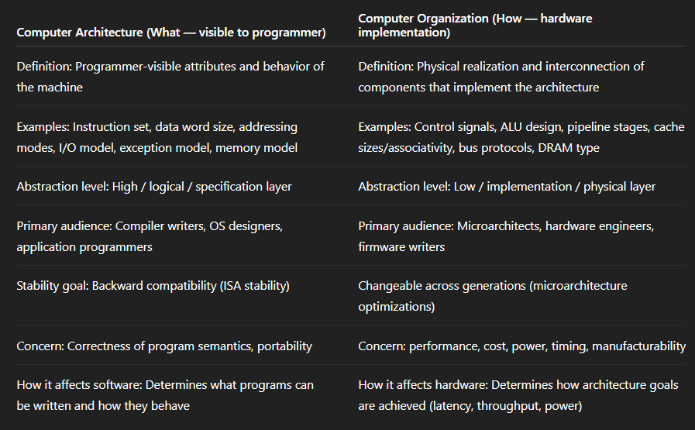

Slide 4
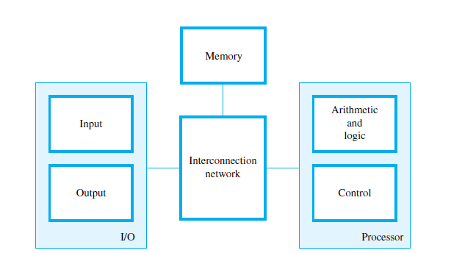
Functional Units
A computer consists of five functionally independent main parts:
Input,
memory,
control units
Arithmetic and logic,
output,

Slide 5
The input unit accepts coded information from human operators using devices such as keyboards, or from other computers over digital communication lines.
The information received is stored in the computer’s memory, either for later use or to be processed immediately by the arithmetic and logic unit.
The processing steps are specified by a program that is also stored in the memory. Finally, the results are sent back to the outside world through the output unit.
All of these actions are coordinated by the control unit.
An interconnection network provides the means for:
the functional units to exchange information
coordinate their actions

Slide 6
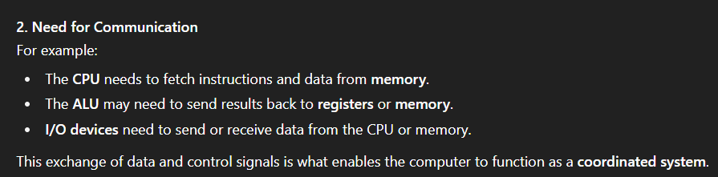
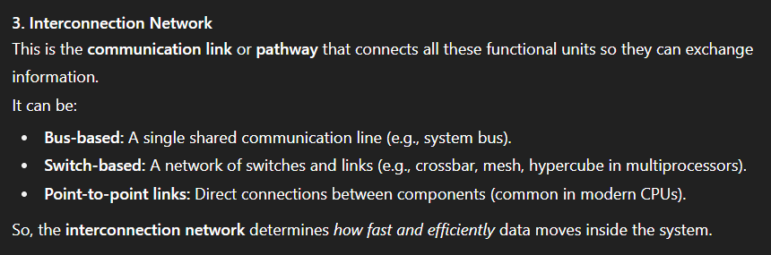
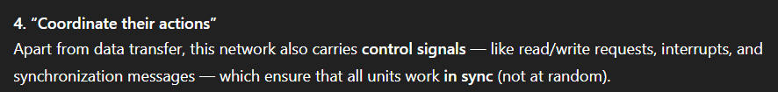

Slide 7
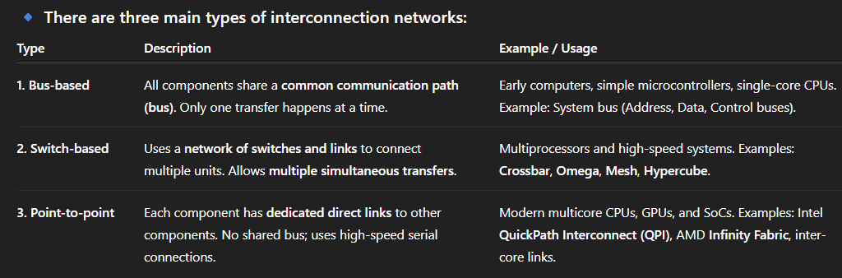

Slide 8
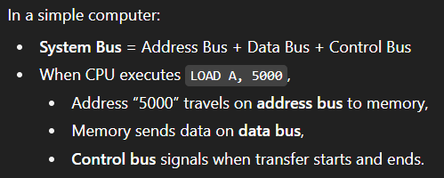
An interconnection network provides the means for:
the functional units to exchange information
coordinate their actions
interconnection Network (System Bus)
Connects all the above components.
Includes three main buses:
Data Bus – transfers data
Address Bus – specifies memory locations
Control Bus – carries control signals (read/write, clock, etc.)

Slide 9
Instruction Set Architecture
A complete instruction set, including operand addressing methods, is often referred to as the instruction set architecture (ISA) of a processor.

Slide 10
Instruction Set Architecture
ISA is the interface between software and hardware.
It defines what the processor can do from a programmer’s perspective.
Every CPU has its own ISA (e.g., x86, ARM, RISC-V, MIPS).
Think of it as the language the CPU understands.
ISA | Used in
x86 / x86-64 - | Intel & AMD desktop/laptop CPUs
ARM - | Mobile devices, embedded systems
RISC-V - | Modern open-source processors
MIPS - | Educational and embedded systems

Slide 11
What does ISA include?
Instruction Set
List of all machine-level instructions the processor can execute.
Example instructions: ADD, SUB, MUL, LOAD, STORE, JUMP, etc.
Operand Addressing Methods
Rules for how instructions access data (operands).
Common addressing modes:
Immediate addressing → Operand is inside the instruction (MOV R1, #5)
Register addressing → Operand is in a register (ADD R1, R2)
Direct addressing → Operand is in memory at a specific address (LOAD R1, [1000])
Indirect addressing → Address of operand is stored in a register (LOAD R1, [R2])
Data Types
What kind of data can be processed? (integers, floats, characters, etc.)
Registers
Number, type, and purpose of processor registers (general-purpose, special-purpose).
🔹 Why is ISA Important?
For Programmers: Defines what instructions they can use when writing assembly code.

Slide 12
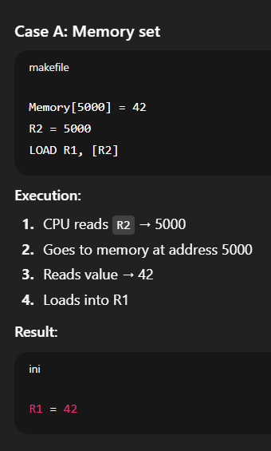
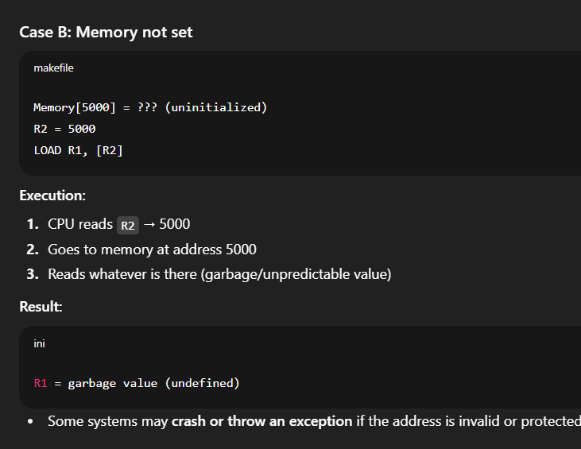

Slide 13
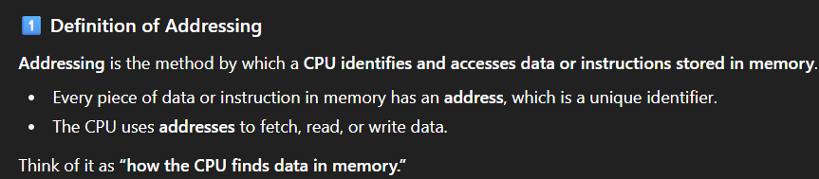
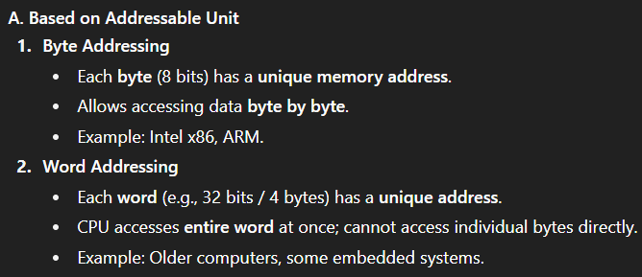
Addressing can be classified in 2 ways:

Slide 14
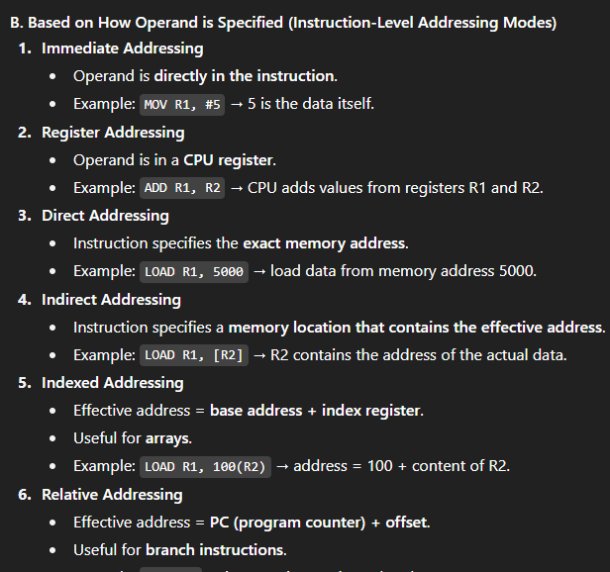

Slide 15
Addressing Mode | Description | Example | Explanation
Immediate | Operand is part of the instruction itself | MOV R1, #5 | The value 5 is directly in the instruction.
Register | Operand is in a CPU register | ADD R1, R2 | CPU adds values stored in registers R1 and R2.
Direct | Instruction specifies the exact memory address | LOAD R1, 5000 | Load data from memory address 5000 directly.
Indirect | Instruction specifies a memory location containing the address | LOAD R1, [R2] | R2 contains the address where the actual data is stored.
Indexed | Effective address = base address + index register | LOAD R1,100(R2) | Useful for accessing array elements.
Relative | Effective address = PC (program counter) + offset | JMP +10 | Useful for branching to instructions relative to current PC.

Slide 16
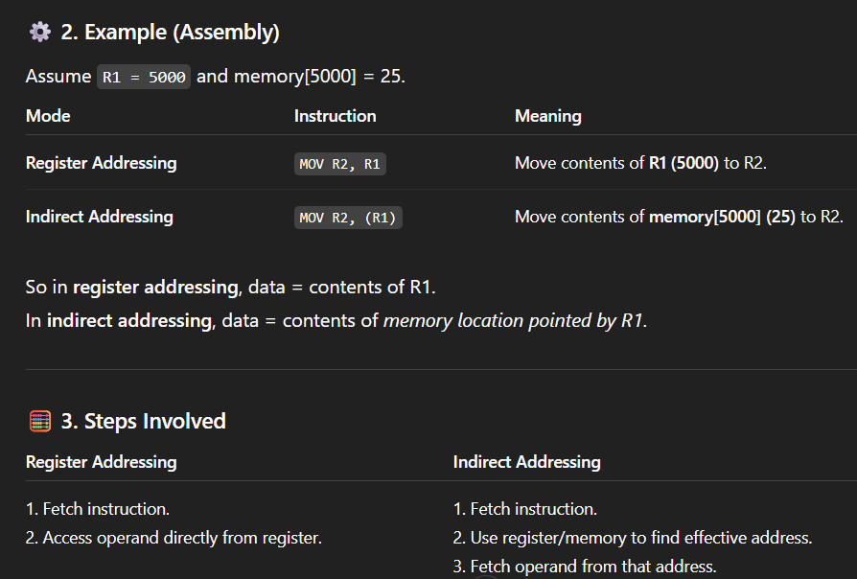

Slide 17
Memory Locations and Addresses
The memory consists of many millions of storage cells, each of which can store a bit of information having the value 0 or 1.
Because a single bit represents a very small amount of information, bits are seldom handled individually.
The usual approach is to deal with them in groups of fixed size.
For this purpose, the memory is organized so that a group of n bits can be stored or retrieved in a single, basic operation.
Each group of n bits is referred to as a word of information, and n is called the word length

Slide 18
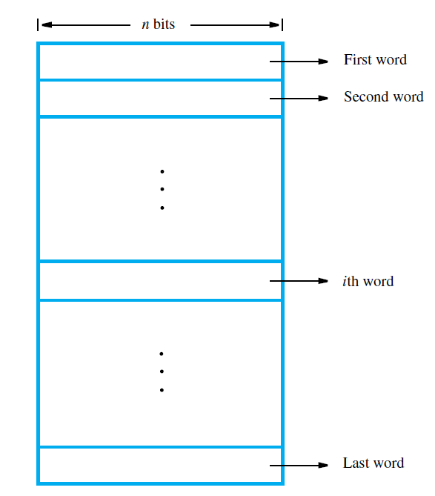
The memory of a computer can be schematically represented as a collection of words, as shown

Slide 19
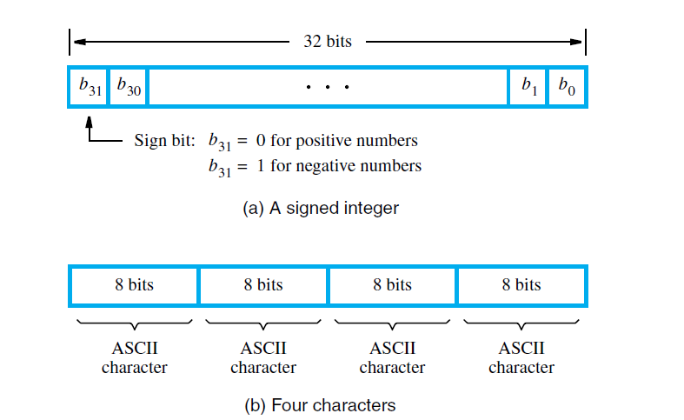
Modern computers have word lengths that typically range from 16 to 64 bits.
If the word length of a computer is 32 bits, a single word can store a 32-bit signed number or four ASCII-encoded characters, each occupying 8 bits, as shown

Slide 20
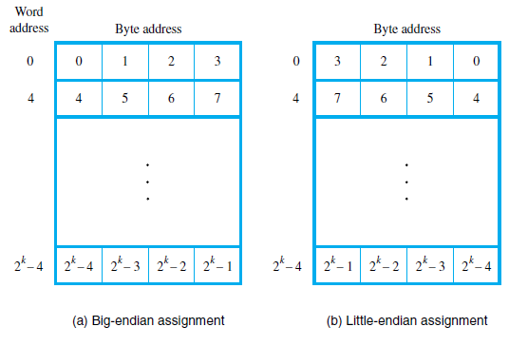
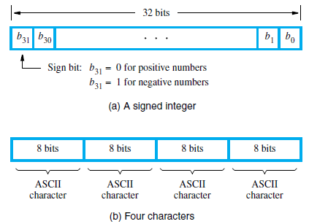
32 bit is represented using 4 bytes and group of 4 bytes form a word so using word addressing we can access all 4 bytes at a time i.e. all 32 bits at a time but can’t access individually single bytes (and 8 bit group)

Slide 21
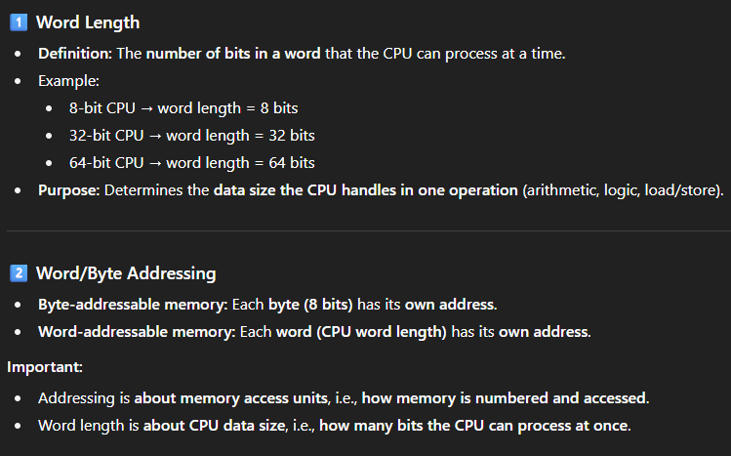

Slide 22
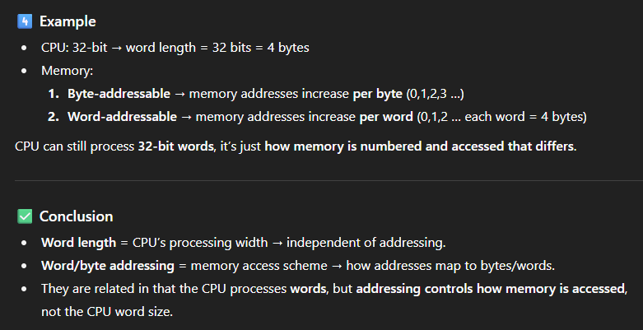

Slide 23
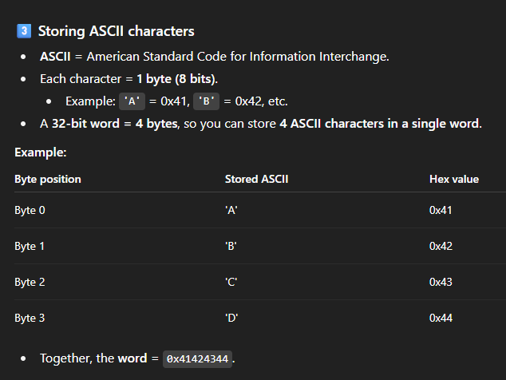
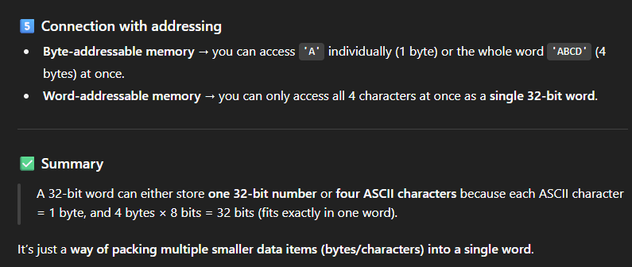
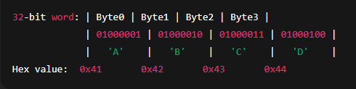

Slide 24
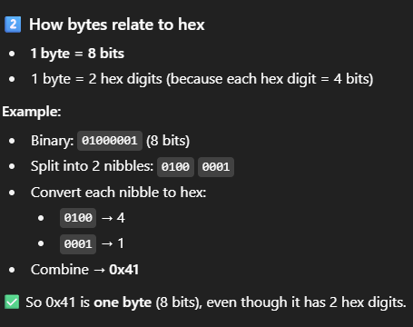
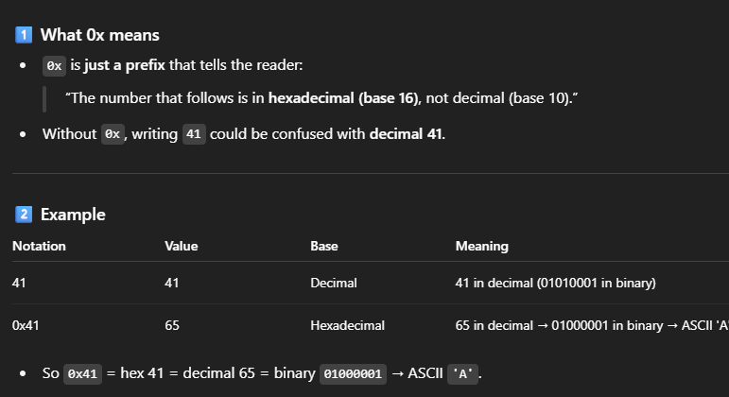

Slide 25
Byte Addressability
Byte addressability means each byte in memory has its own unique address, allowing the CPU to access data at the granularity of 8 bits. In such a system, the CPU can access, read, or write data one byte at a time.
If a memory is byte-addressable, then each byte has a distinct address — not each word or block.
Two ways that byte addresses can be assigned across words
Big-Endian: lower byte addresses are used for the most significant bytes of the word
Little-Endian: opposite ordering. Lower byte addresses are used for the less significant bytes of the word

Slide 26
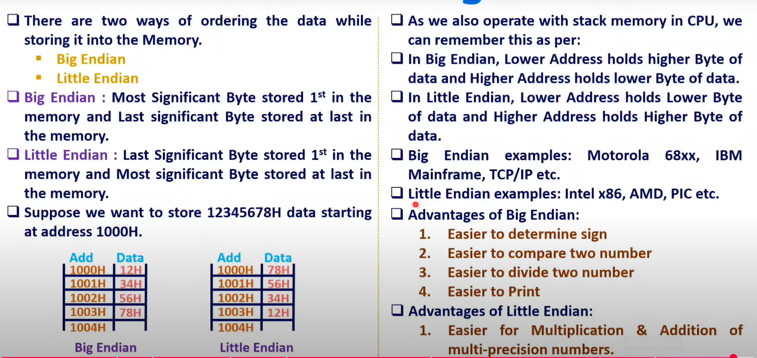

Slide 27
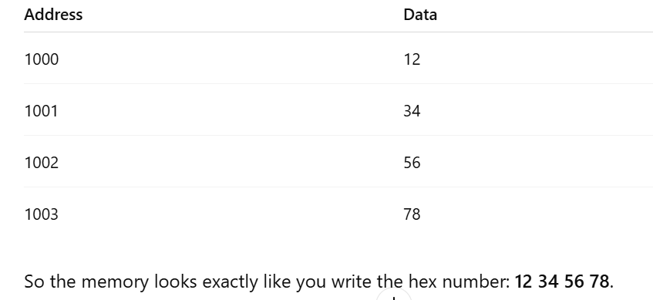
Definition: The most significant byte (MSB) is stored at the lowest memory address.
Think: “Big end first.”Example: Store the 32-bit number 0x12345678 in memory at address 1000.

Slide 28
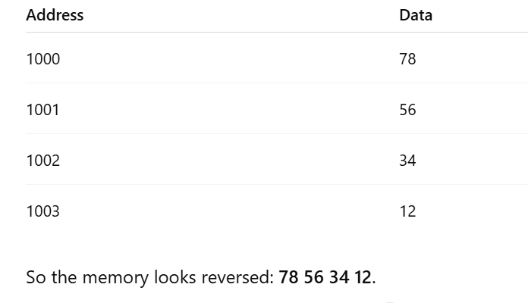
Little Endian (LE)Definition: The least significant byte (LSB) is stored at the lowest memory address.
Think: “Little end first.”Example:
Store the same number 0x12345678 at address 1000.

Slide 29
Where they are usedBig Endian: Historically used in older systems (Motorola, IBM mainframes, some network protocols).
Little Endian: Most modern PCs (Intel x86, AMD) use it.
Networking: By convention, network byte order = Big Endian

Slide 30
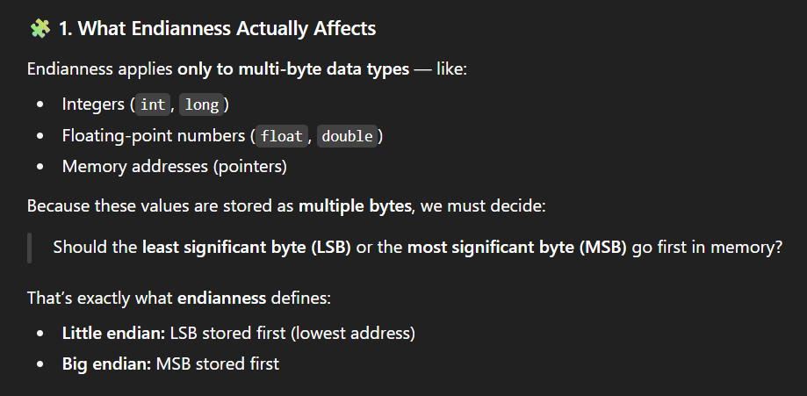

Slide 31
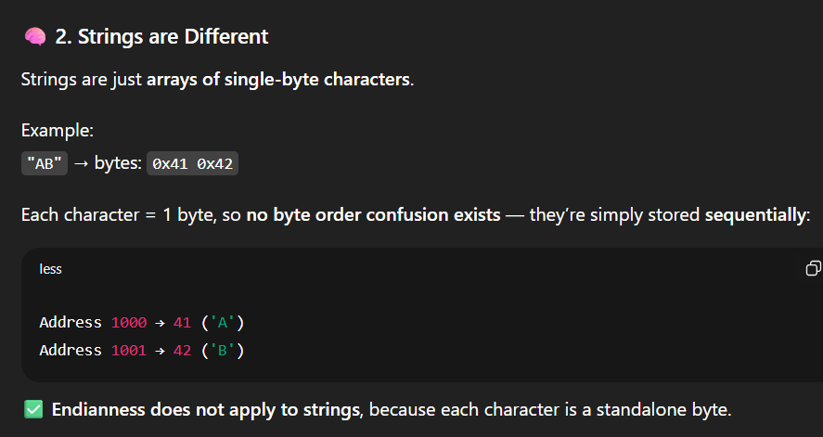

Slide 32
Word Alignment
Word locations have aligned addresses if they begin at a byte address i.e., a multiple of the number of bytes in a word.
16-bit word: word addresses: 0, 2, 4,….
32-bit word: word addresses: 0, 4, 8,….
64-bit word: word addresses: 0, 8,16,….
If words begin at arbitrary byte address, words are said to have unaligned addresses.

Slide 33
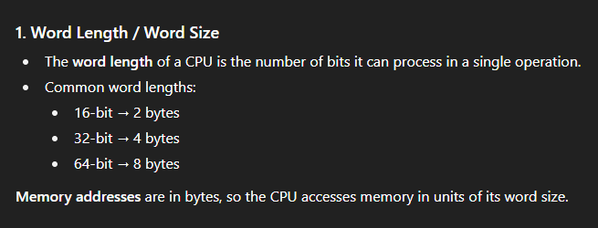
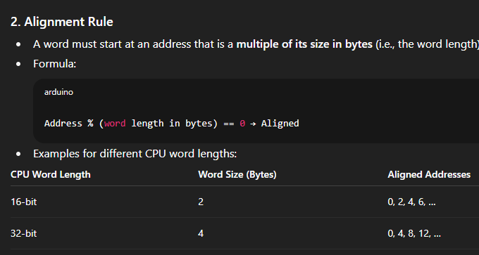

Slide 34
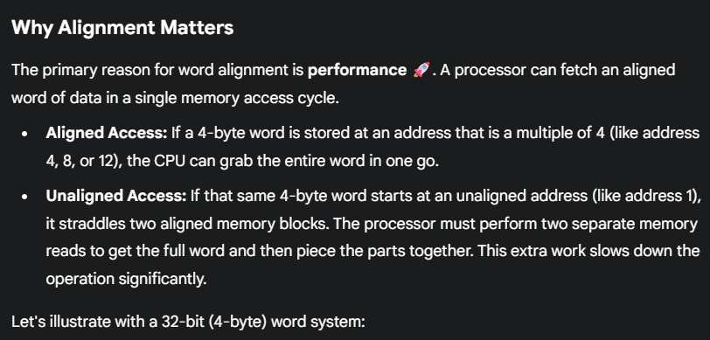

Slide 35
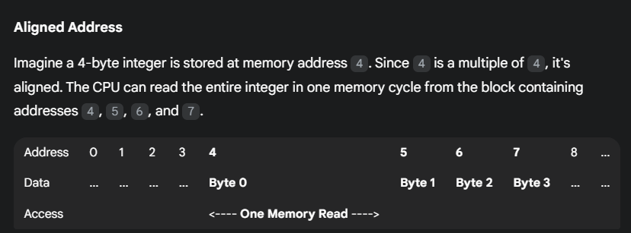
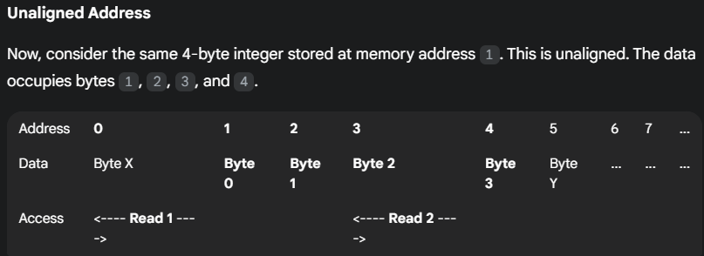
In Unaligned, To get the full integer, the CPU must:
Read the first block (addresses 0-3) and take the last three bytes.
Read the second block (addresses 4-7) and take the first byte.
Combine these pieces to reconstruct the integer.

Slide 36
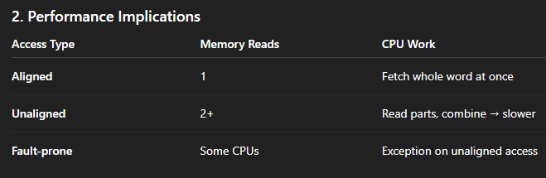
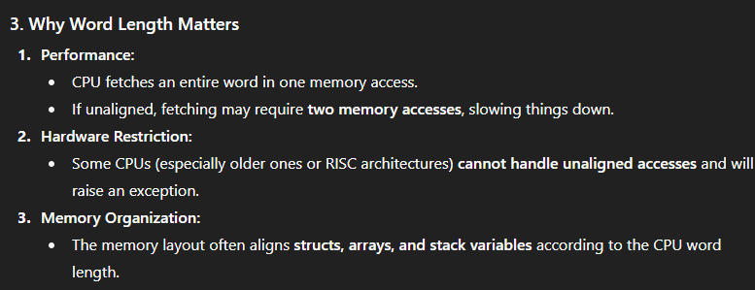

Slide 37
Accessing Numbers and Characters
A number usually occupies one word and can be accessed in the memory by specifying its word address.
Individual characters can be accessed by their byte address.
A number usually occupies one word→ Numbers like integers or floats are stored across multiple bytes (depending on word size). To access them, we specify their word address, not each byte separately.
Individual characters can be accessed by their byte address→ Since each character fits in 1 byte, we can directly refer to it by its byte address.

Slide 38
Example::
Example (32-bit = 4-byte word)
Suppose we want to store the integer 100 (0x00000064) and the string "AB".
Memory layout:

Slide 39
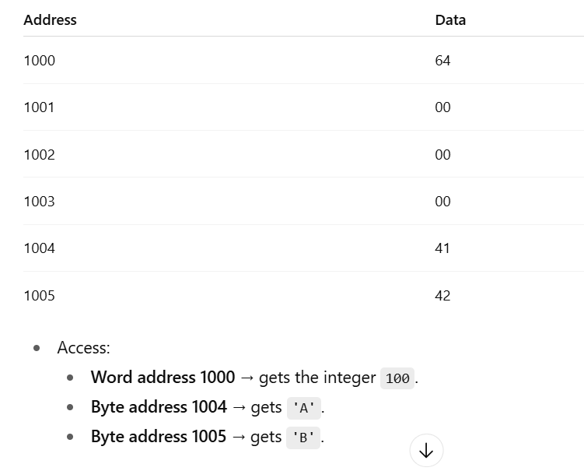

Slide 40
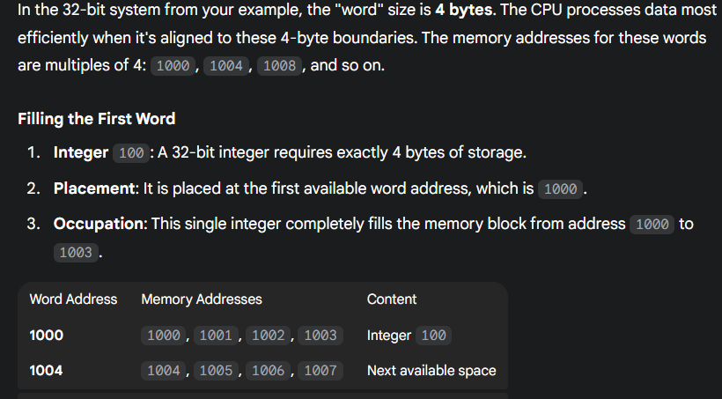
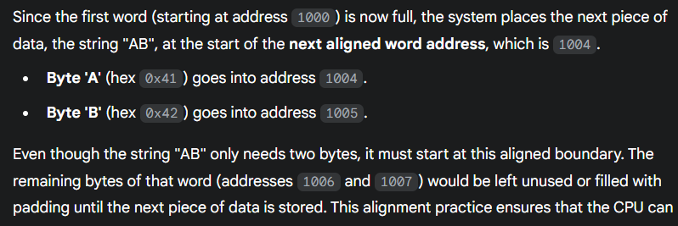

Slide 41
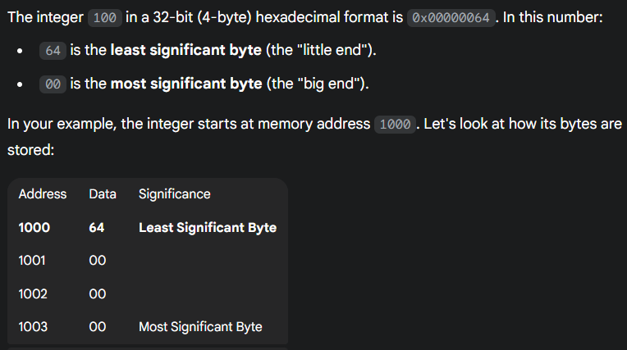
The example in previous slide is Little Endian: Because the least significant byte (64) is stored at the lowest memory address (1000), the system is defined as little-endian.
A big-endian system would have stored it in the opposite order, with the most significant byte (00) at the starting address 1000.

Slide 42
Memory Operations
Load (or Read or Fetch) – Memory Read Operation
Copy the content. The memory content doesn’t change.
Address – Load
Registers can be used
Store (or Write) – Memory Write Operation
Overwrite the content in memory
Address and Data – Store
Registers can be used

Slide 43
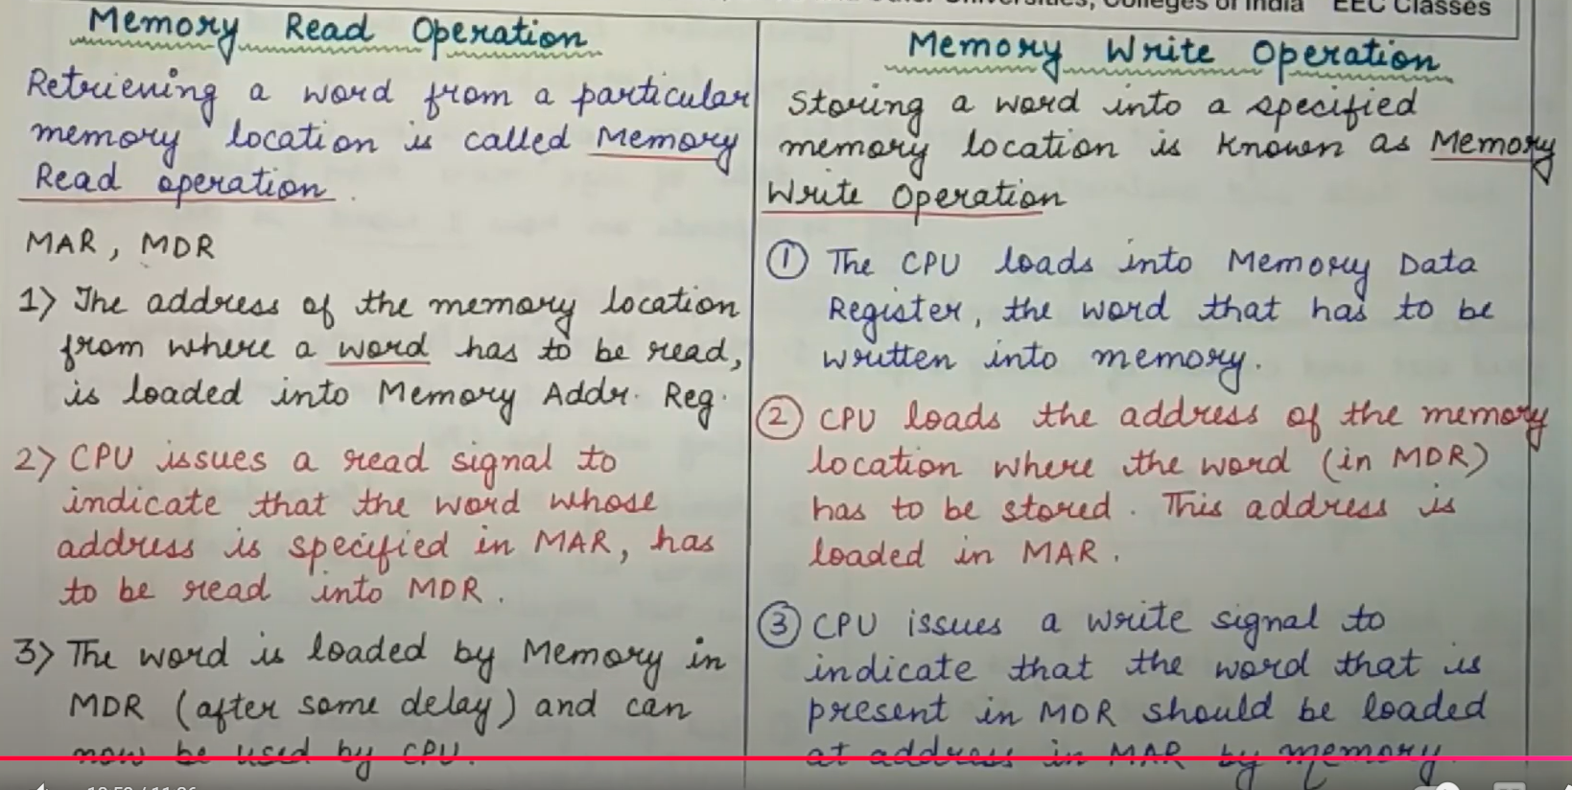

Slide 44
1. Memory Read (Memory → CPU)
When the CPU wants to fetch some data from memory:
CPU puts the memory address (from which data should be read) on the address bus.
CPU asserts the control signal READ (also called MemRead).
The memory module places the requested data on the data bus.
CPU reads the data from the bus into a register

Slide 45
Memory Write (CPU → Memory)
When the CPU wants to store some data in memory:
CPU puts the memory address (where data should be stored) on the address bus.
CPU places the data to be stored on the data bus.
CPU asserts the control signal WRITE (also called MemWrite).
The memory module receives the signal and writes the data into the specified location.

Slide 46
Who actually performs it?
CPU (Control Unit): Issues commands (read/write).
Memory (RAM/Cache): Responds by supplying or storing data.
System Buses: Carry the address, data, and control signals between CPU and memory.
So, CPU initiates the operation, and memory executes it.

